Slide 1
Health Diagnosis System

Slide 2
Project Guide:
M. Shashidhar
Assistant Professor
Batch:CSE-A21
Team Members:
1.B.Sai Kiran (219X1A05B0)
2.C.Yaswanth (219X1A05B5)
3.R.Mahmood Shariff (219X1A05G3)

Slide 3
Abstract of the Project
The core of the project involves creating a suite of machine learning algorithms designed to analyze a range of diagnostic data, including patient symptoms, clinical histories, lab results, and imaging studies. By employing techniques such as supervised learning, neural networks, and ensemble methods, the project seeks to build models that can predict the likelihood of various conditions based on historical and real-time data.
A project would be very useful in the medical field and machine learning- based web application would be created for medical diagnosis. For a medical diagnosis, a machine learning model would be developed and integrated with the created web application. The user would be able to upload his medical data on the web application. The web application would pass this data to a developed machine learning model for health disease detection. After analysing the user’s data it predicts the health condition of the user.

Slide 4
Kidney Disease Prediction Using Random Forest Machine Learing Algorithm

Slide 5
Introduction to Kidney Disease
Kidney disease is a significant global health issue, affecting millions of individuals worldwide.
Early detection and intervention can significantly improve patient outcomes and reduce healthcare costs.
Machine learning algorithms, such as random forests, play a crucial role in enhancing prediction accuracy for kidney disease.
Notes:
Image source: https://www.slidemake.com

Slide 6
Overview of Random Forest Algorithm
Random Forest is an ensemble learning method that combines multiple decision trees to improve prediction accuracy.
It operates by generating a diverse set of trees through bootstrapping and feature randomness, which helps in reducing overfitting.
The final prediction is made based on the majority voting from individual trees, enhancing robustness and reliability.
Notes:
Image source: https://miro.medium.com

Slide 7
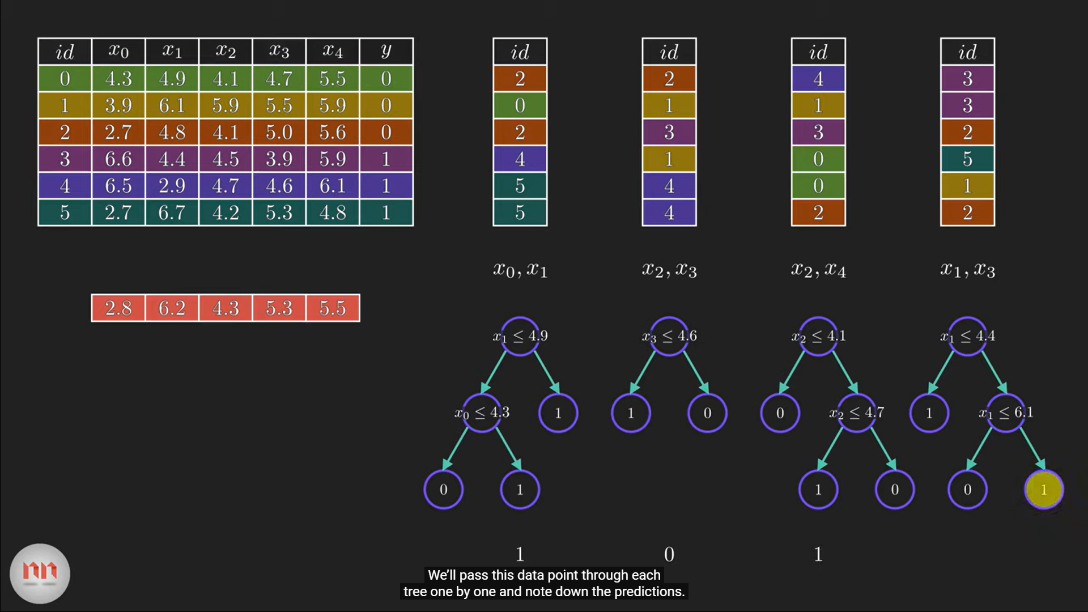

Slide 8

Data Collection and Preparation
High-quality data is essential for training an effective random forest model for kidney disease prediction.
Commonly used datasets include various clinical parameters, demographic information, and laboratory results.
Data preprocessing steps, such as handling missing values and normalization, are crucial for optimal model performance.
Notes:
Image source: https://onlinetoolguides.com

Slide 9
Model Training and Evaluation
The random forest model is trained using labeled datasets, where the outcome variable indicates the presence of kidney disease.
Model evaluation is performed using metrics such as accuracy, precision, recall, and the area under the ROC curve.
Cross-validation techniques ensure that the model generalizes well to unseen data and maintains high predictive performance.
Notes:
Image source: https://www.researchgate.net

Slide 10
Importance of Feature Selection
Feature selection is vital in random forests to identify the most relevant predictors for kidney disease.
Techniques such as Gini importance and permutation importance help in determining the contribution of each feature.
Reducing the number of features not only enhances model interpretability but also improves computational efficiency.
Notes:
Image source: https://www.researchgate.net

Slide 11
Future Directions and Challenges
Despite its effectiveness, challenges such as data imbalance and feature interactions remain in kidney disease prediction.
Future research may focus on integrating random forests with other machine learning techniques to enhance predictive performance.
Ongoing advancements in artificial intelligence can further refine models and facilitate personalized medicine approaches for kidney disease.
Notes:
Image source: https://www.researchgate.net

Slide 12
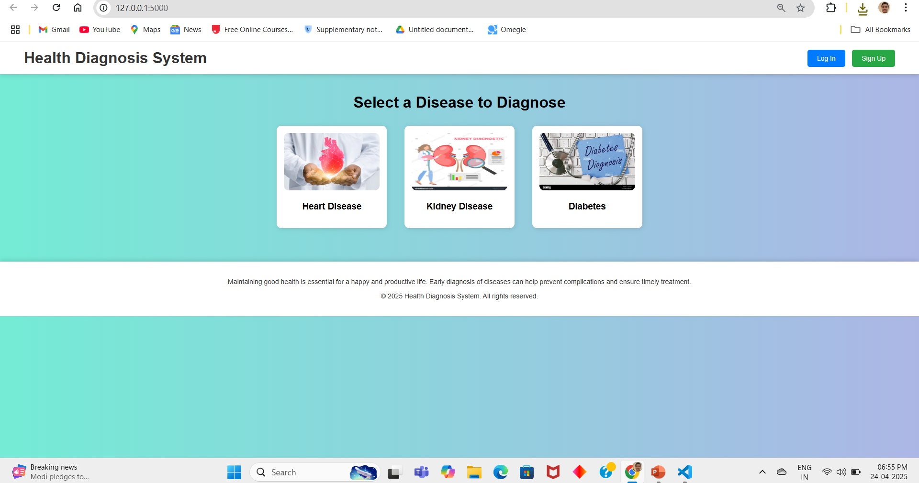

Slide 13
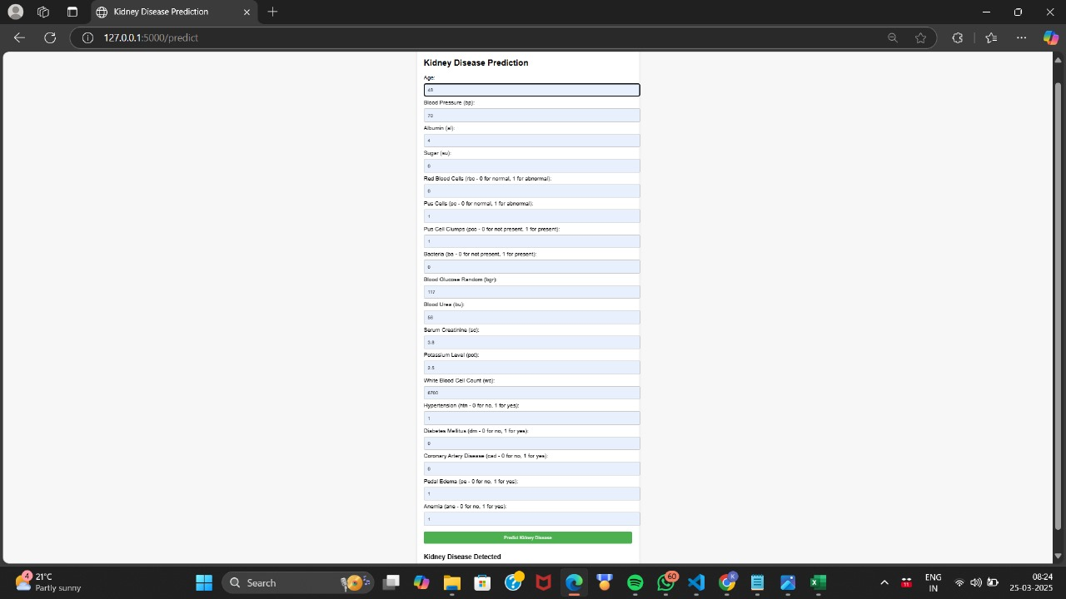
Kidney disease Prediction and its inputs and outputs(for positive results)

Slide 14
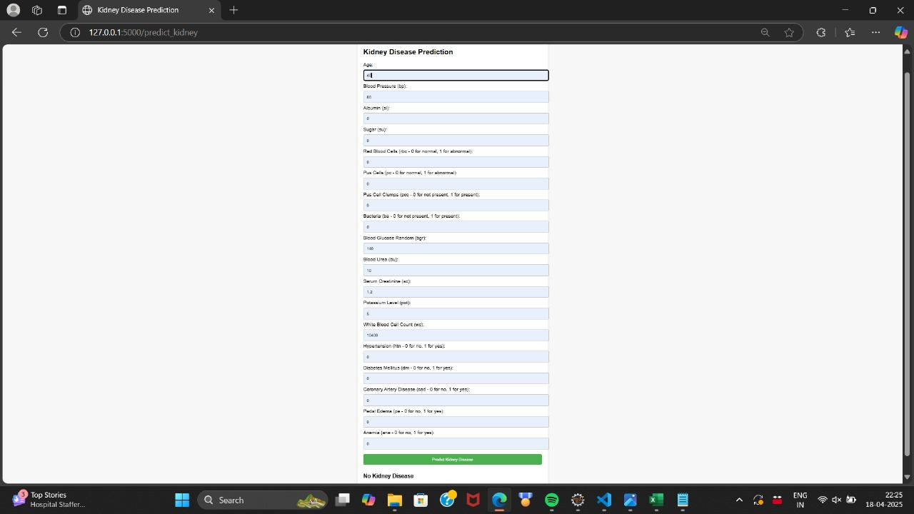
Kidney disease prediction for Negative Results

Slide 15
KNN Algorithm for Diabetes Prediction
1.Dataset Selection: We used a dataset related to diabetes, which includes relevant medical
features to predict outcomes.
2. Library Import: Essential Python libraries, such as pandas, NumPy, KNN Neighbors Classifier and scikit-learn, were imported to handle data manipulation, preprocessing, and machine learning tasks.
3.Data Preprocessing :The data was cleaned and prepared, including handling missing values, encoding categorical variables (if any), and normalizing features using MinMaxScaler
4. Data Splitting: The dataset was divided into training and testing subsets to evaluate the model’s performance effectively.

Slide 16
Diabetes Prediction Using KNN Classifier Algorithm
I implemented the K-Nearest Neighbors-Classifier from scikit-learn to build and train the k-nearest neighbors classification model, leveraging its simplicity and effectiveness for the given diabetes dataset.
K Nearest Algorithm uses a kth Point. Which comes to nearer to that point then it decides it as a true one it means that person has Diabetes ,if it is far then person does not have Diabetes Problem

Slide 17
3.Feature Selection
The performance of ML models depends on the quality of the features used as input. As the number of features in the datasets increases, the prediction performance of the model decreases. By reducing the number of features, the model can obtain more accurate results and work faster and more efficiently. ML models are designed according to the data used in the learning process.
Selecting the best features makes the features learned by the model more generalizable. Thus, it makes the model work better with new data.
Dataset Features
1.Age
2.Pregnancies
3.Insulin Level
4.Glucose level
5.Diabetes Pedigree Level
6.Blood Pressure
7.Skin Thickness
8.Body Mass Index(BMI)

Slide 18
Diabetes Prediction
We performed some performance matrix parameters like accuracy Score, Precision Score,f1 Score, Recall etc.
The Accuracy of KNN Classifier is 78.57%
Then I exported it using pickle file from Machine Learning Model
We importing this file app.py.py file that we get a establishment.

Slide 19
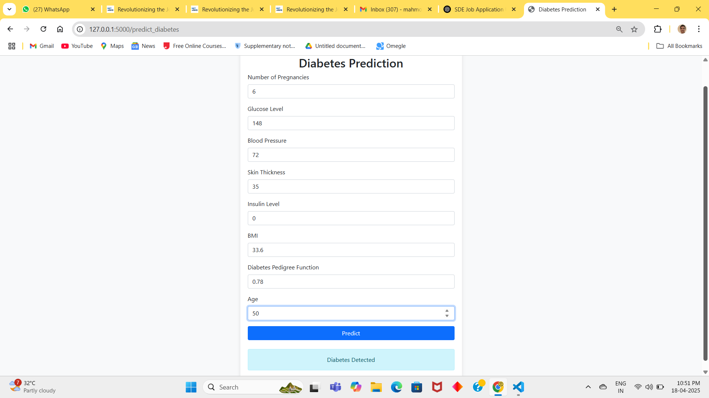
Diabetes Prediction and its input and Ouputs(positive Result)

Slide 20
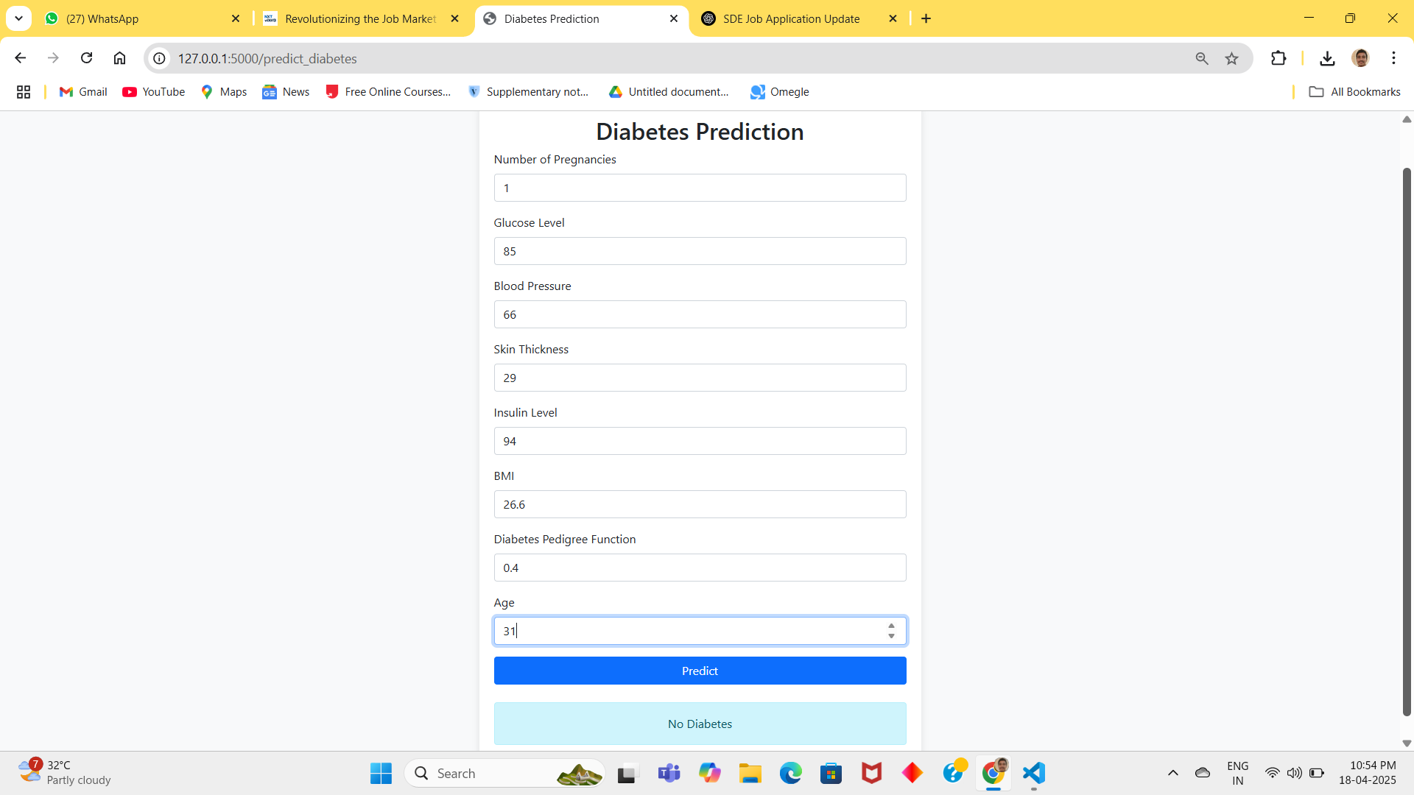
Diabetes Prediction for Negative Result(not having diabetes)

Slide 21
Heart Disease prediction
1.Introduction
According to the World Health Organization, even though there have been big improvements in diagnosing and treating heart problems, heart disease is still the leading cause of death worldwide, causing about one-third of all deaths each year.
"Heart disease" is a broad term that covers several heart conditions, such as Coronary Artery Disease, irregular heartbeats (Arrhythmia), problems with heart valves, and Heart Failure, where the heart can't pump blood properly.
2.Dataset
The Cleveland heart disease dataset is commonly used for heart disease prediction with supervised Machine Learning. The Cleveland dataset is obtained from the Kaggle Machine Learning repository. The Cleveland dataset was collected for use in a study in the field of health research by the Cleveland Clinic Foundation in 1988.
In the original of this dataset, 76 different features of 303 subjects were recorded. However, it is known that most researchers use only 14 of these features, including the target class feature.

Slide 22
3.Feature Selection and Dimension Reduce
The performance of ML models depends on the quality of the features used as input. As the number of features in the datasets increases, the prediction performance of the model decreases, and the computational costs increase. By reducing the number of features, the model can obtain more accurate results and work faster and more efficiently. ML models are designed according to the data used in the learning process.
Selecting the best features makes the features learned by the model more generalizable. Thus, it makes the model work better with new data.
Dataset Features
1.Age
2.Gender
3.Cp
4.Trestbps
5.Chol
6.Fbs
7.Slope
8.Ca
9.Thal
10.Target

Slide 23
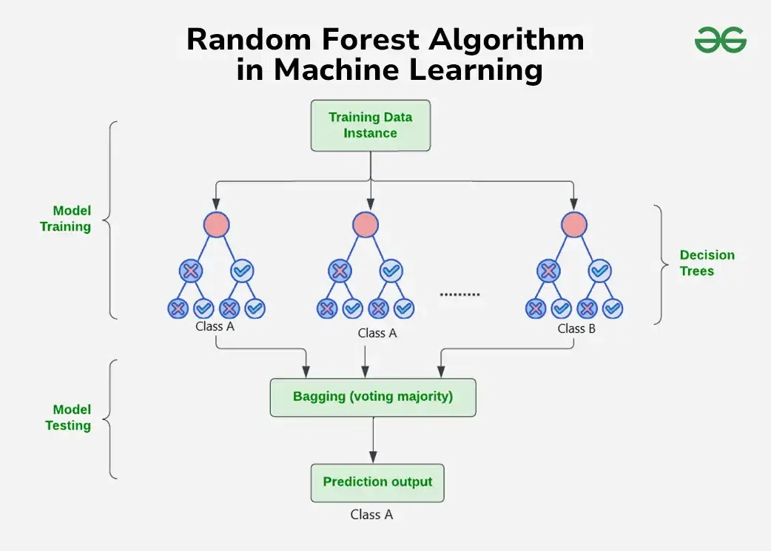
4.Machine Learning Model
Decision Tree
Decision tree is a simple diagram that shows different choices and their possible results helping you make decisions easily.
Random Forest
A Random Forest is a collection of decision trees that work together to make predictions

Slide 24
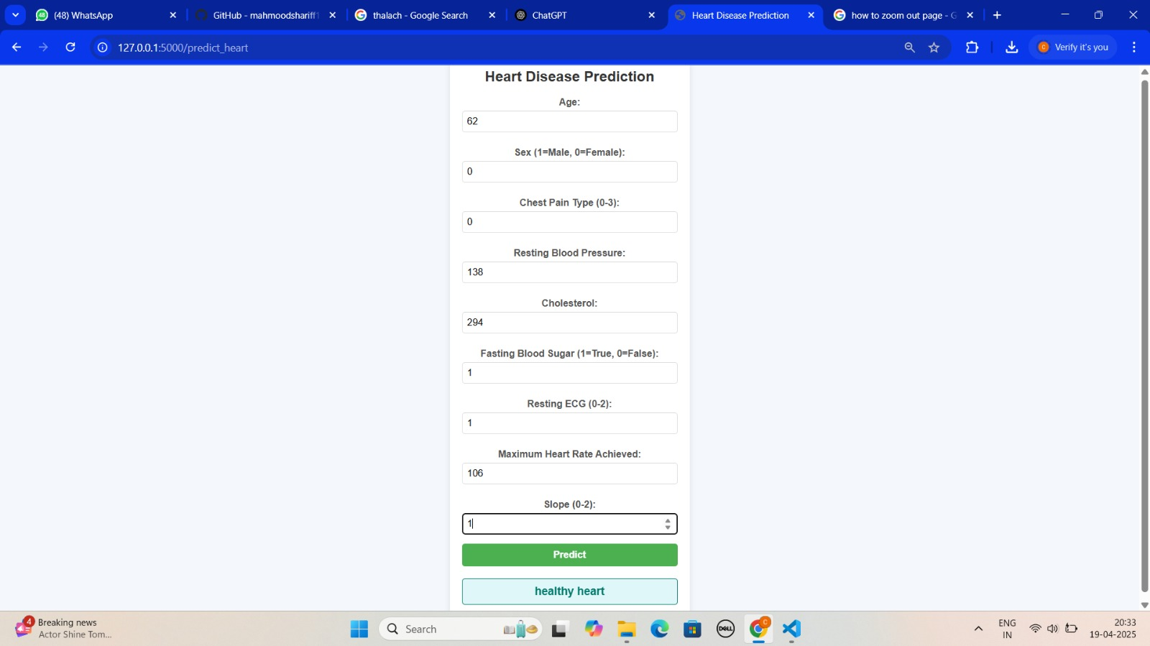
Heart Prediction with Inputs and Outputs(for Negative Result)

Slide 25
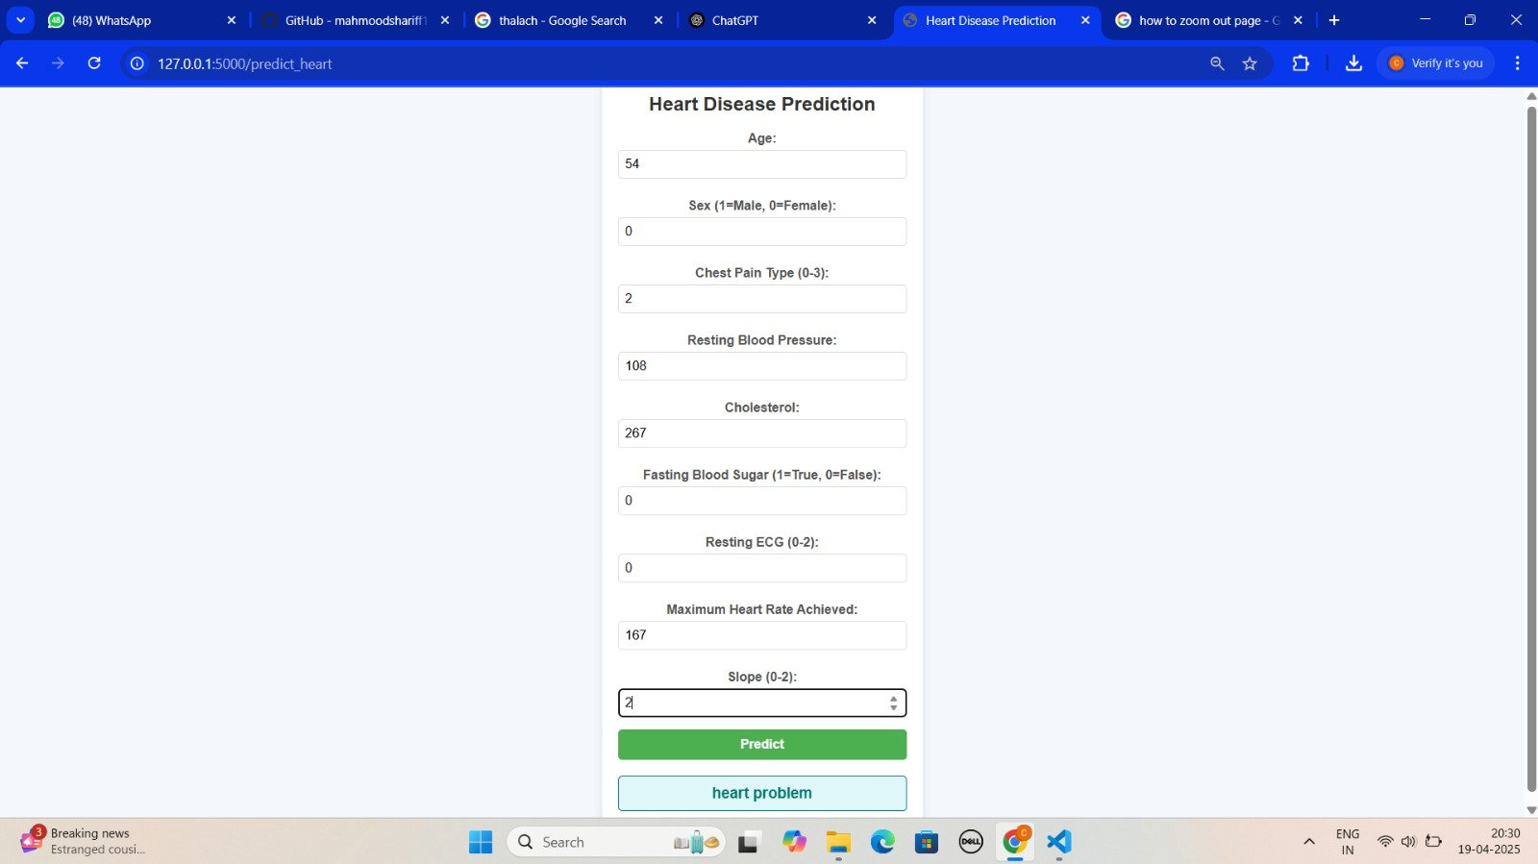
Prediction for Positive Result (for Positive Result)

Slide 26
Thank You

